Slide 1
Power System Management
By: Muhammad Danish bin Shukor (1813773)

Slide 2
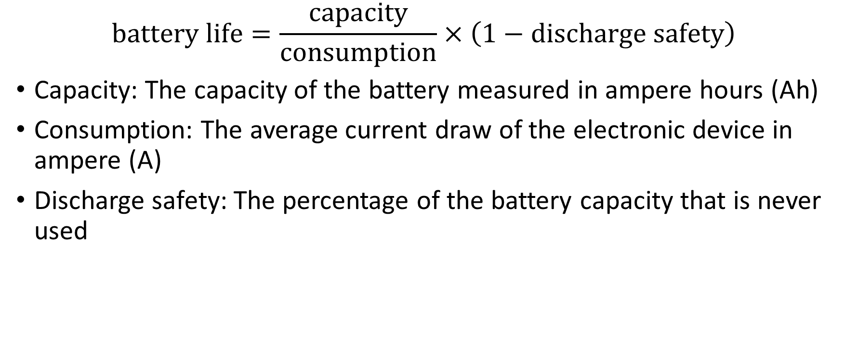
Battery life calculation
$$battery life=\frac{capacity}{consumption}×\left(1−discharge safety\right)$$
Capacity: The capacity of the battery measured in ampere hours (Ah)
Consumption: The average current draw of the electronic device in ampere (A)
Discharge safety: The percentage of the battery capacity that is never used

Slide 3
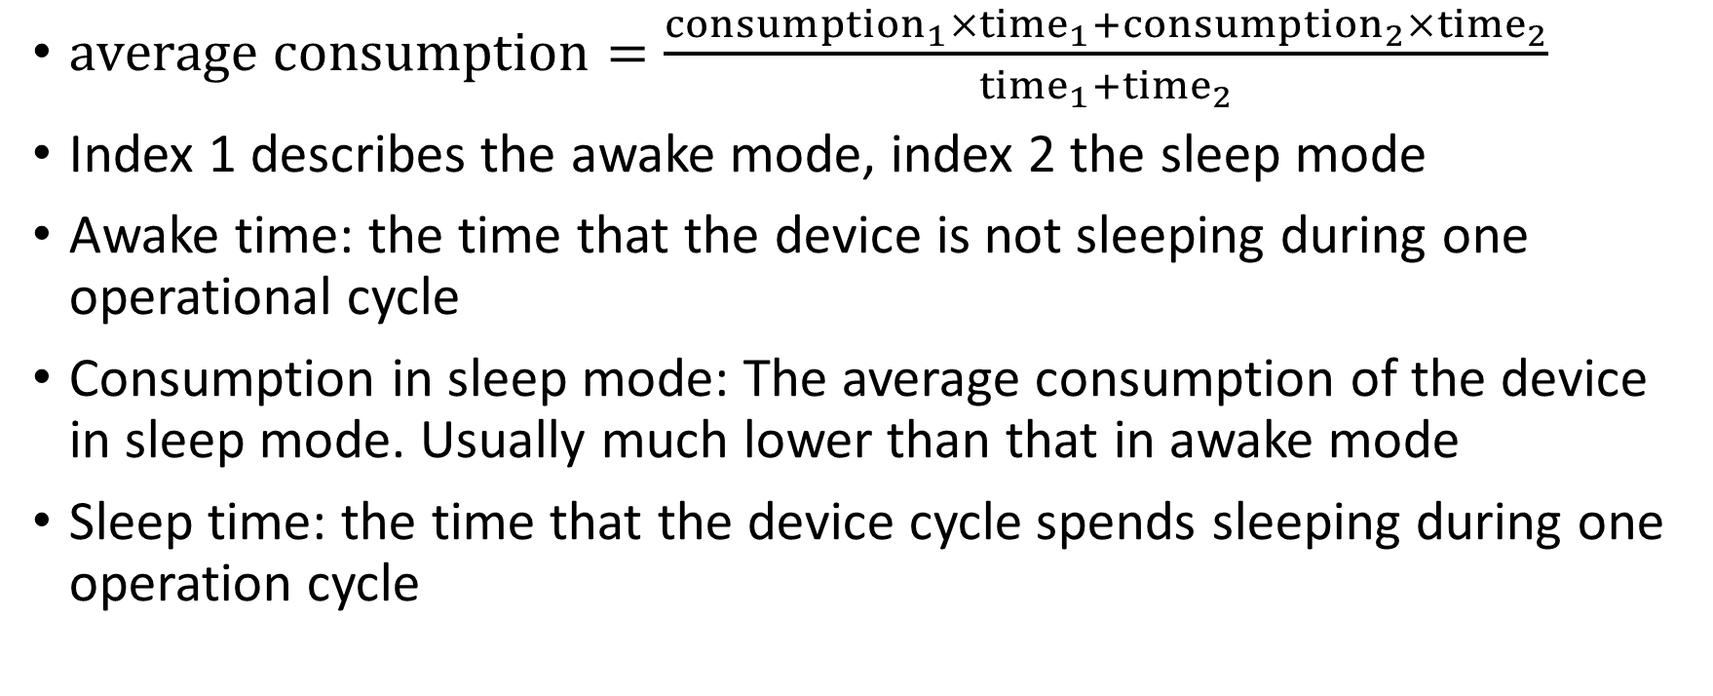
Battery life after a recharge
$average consumption=\frac{{consumption}_{1}×{time}_{1}+{consumption}_{2}×{time}_{2}}{{time}_{1}+{time}_{2}}$
Index 1 describes the awake mode, index 2 the sleep mode
Awake time: the time that the device is not sleeping during one operational cycle
Consumption in sleep mode: The average consumption of the device in sleep mode. Usually much lower than that in awake mode
Sleep time: the time that the device cycle spends sleeping during one operation cycle

Slide 4
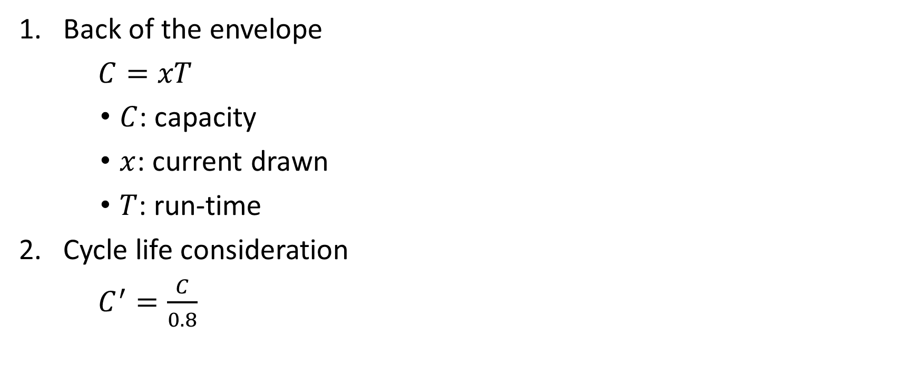
Battery run-time calculation (based on amps)
Back of the envelope
$C=xT$
$C$: capacity
$x$: current drawn
$T$: run-time
Cycle life consideration
$C^{′}=\frac{C}{0.8}$

Slide 5
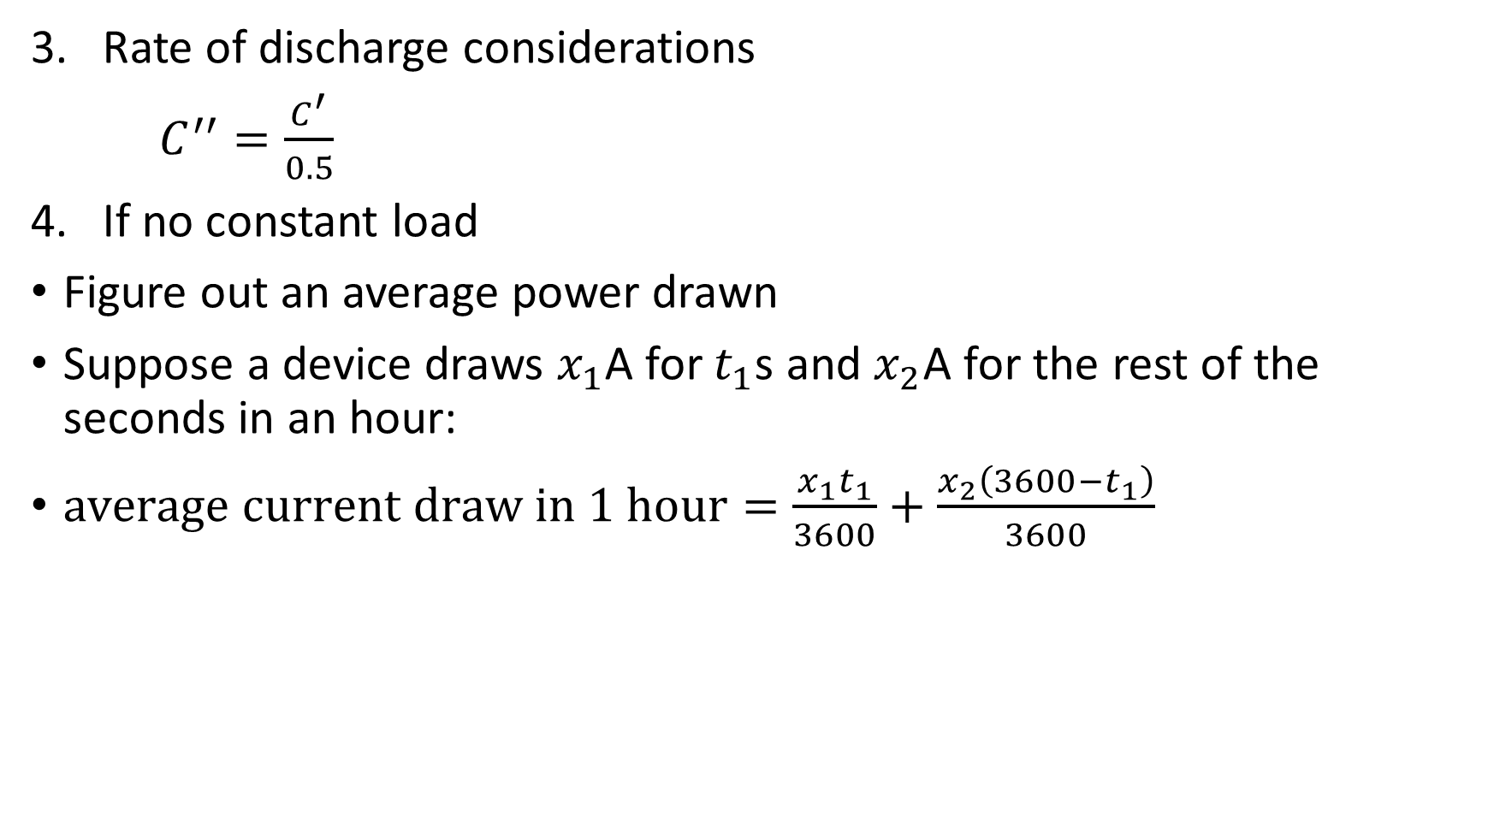
Rate of discharge considerations
$C^{′′}=\frac{C^{′}}{0.5}$
If no constant load
Figure out an average power drawn
Suppose a device draws $x_{1}$A for $t_{1}$s and $x_{2}$A for the rest of the seconds in an hour:
$average current draw in 1 hour=\frac{x_{1}t_{1}}{3600}+\frac{x_{2}\left(3600−t_{1}\right)}{3600}$

Slide 6
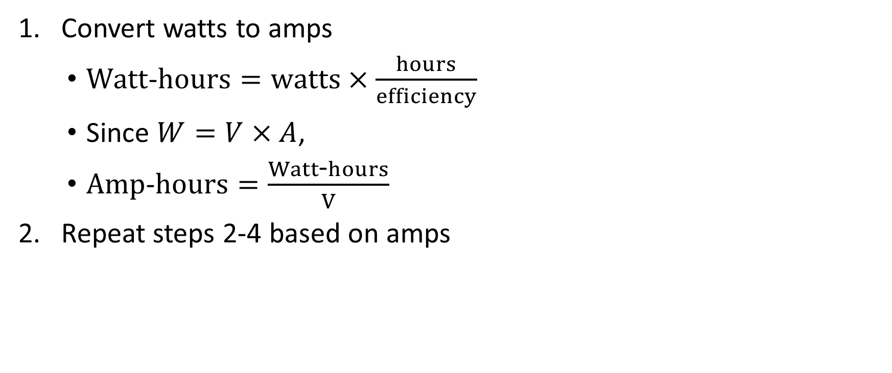
Battery run-time calculation (based on Watt)
Convert watts to amps
$Watt$-$hours=watts×\frac{hours}{efficiency}$
Since $W=V×A$,
$Amp$-$hours=\frac{Watt\text{-}hours}{V}$
Repeat steps 2-4 based on amps

Slide 7
Types of batteries and their applications
Primary (non-rechargeable)
Secondary (rechargeable)

Slide 8
Primary batteries
Battery type | Characteristics | Applications
Alkaline (Zn/Alkaline/MnO₂) | Very popular, moderate cost, high performance | Most popular primary batteries
Magnesium (Mg/MnO₂) | High capacity, long shelf life | Military and aircraft radios
Mercury (Zn/HgO) | Very high capacity, long shelf life | Medical (hearing aids, pacemakers), photography
Lithium/Solid Cathode | High energy density, low temp performance, long shelf life | Replacement for button and cylindrical cells
Lithium/Soluble Cathode | High energy density, good performance, wide temp range | Wide range applications with a capacity between 1 – 10,000 Ah
Lithium/Solid Electrolyte | Low power, extremely long shelf life | Memory circuits, medical electronics
Silver/Zinc (Zn/Ag₂O) | Highest capacity, costly, flat discharge | Hearing aids, photography, pagers
Zinc – Carbon | Common, low cost, variety of sizes | Radios, toys, instruments

Slide 9
Secondary batteries
The main advantage of these batteries is they can be recharged and reused.
Usually cost more than primary ones, but have a longer lifespan.
Applications:
Energy storage devices like Uninterrupted Power Supplies (UPS) and Hybrid Electric Vehicles (HEV)
Applications where the battery is used and discharged as a primary battery
Mobiles
Laptops

